Slide 1
Estimating Days to CLose
By Joel Woznicki

Slide 2
Quicken LoaNs Overview
Top Retail lender Q1 2018
Rocket Mortgage
Data from 2017 Closed Refinance
Over 296,268 closings

Slide 3
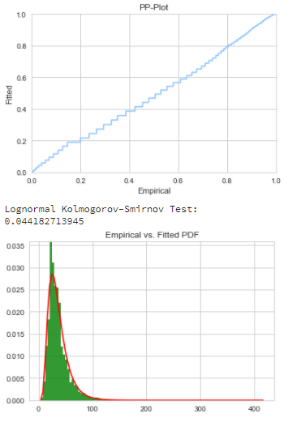
Target Variable
daysToClose
Total mortgage transaction length from underwriting to signing
Median: 31 Days

Slide 4
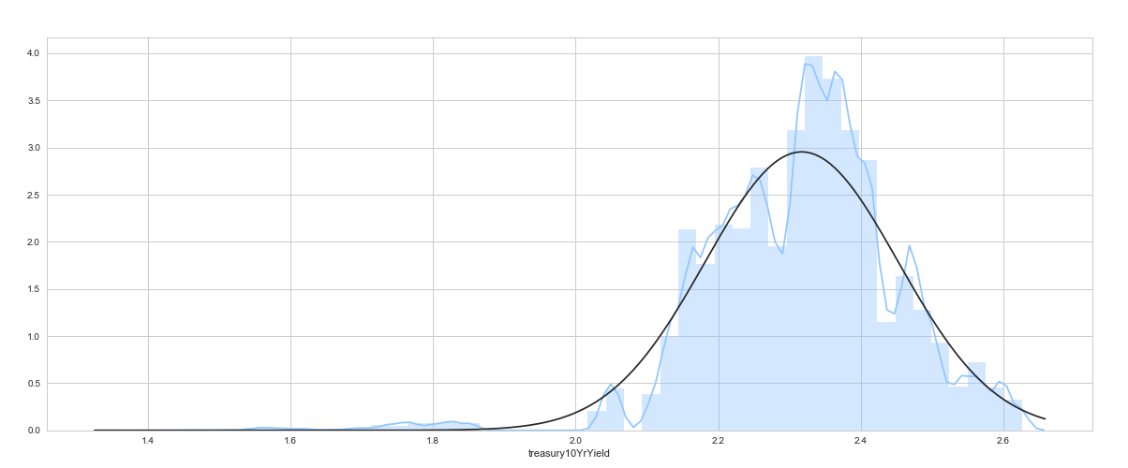
Features
10 Year Treasury Yield
Rate for 10 Year Treasury Bonds
Rising rates drives up mortgage interest rates

Slide 5
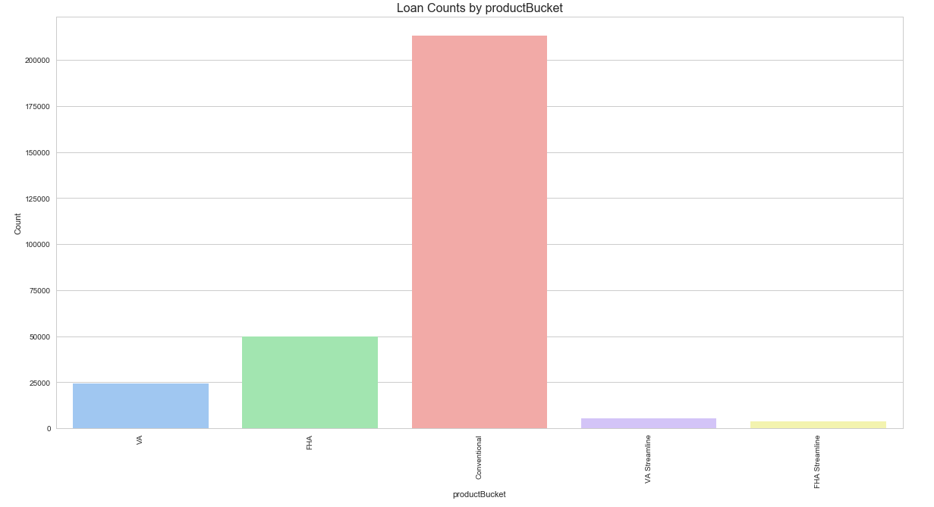
Features
productBucket
Conventional, FHA, VA
Depending on creditworthiness, downpayment, etc.

Slide 6
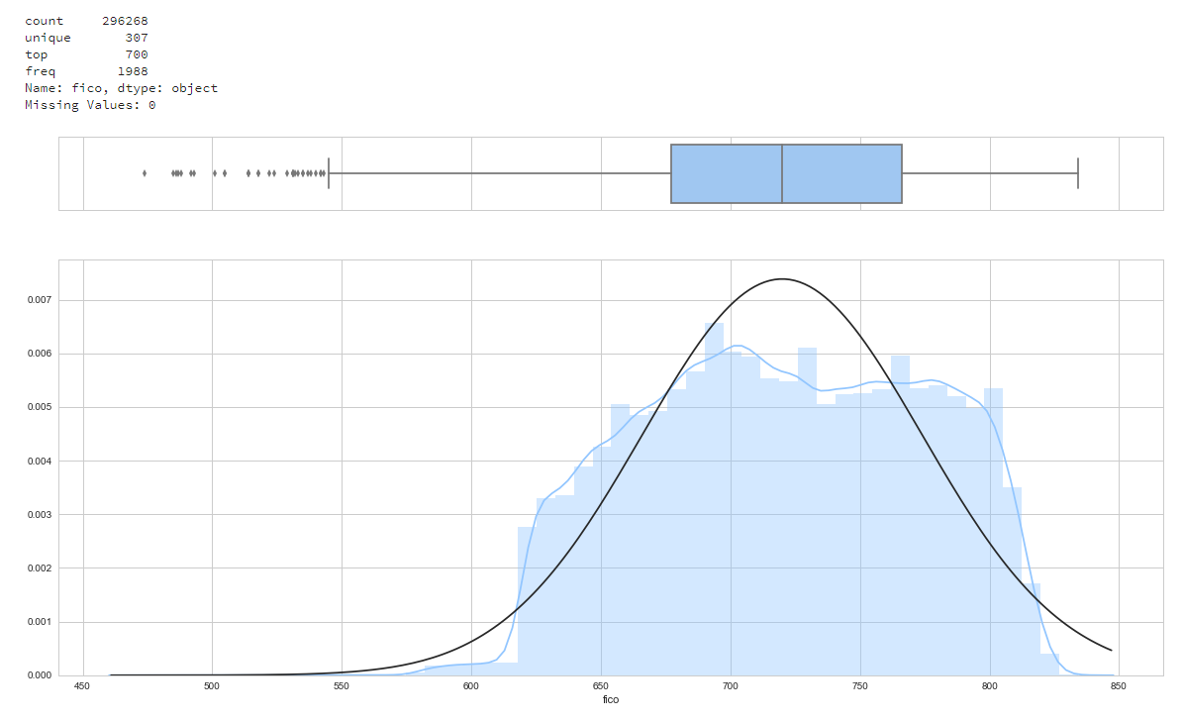
Features
fico
Credit Score
Median: ~700

Slide 7
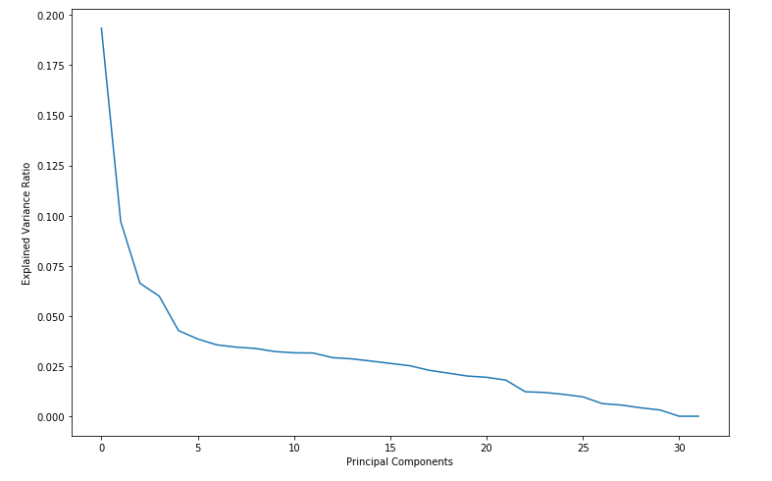
PREProcessing
Impute numeric with Median
Scale numeric with Robust Scaler
Uses interquartile range
One-hot encode categorical
PCA

Slide 8
Estimation Biases
Current Refinances are motivated by:
Rising Rates
Equity Increases
Appraisal expectations

Slide 9
Initial Issues with Regression
Data Leakage:
Much of the data was changed just before closing and well after underwriting, that had to be thrown out
One – hot encoding:
Feature encoding did not match between train and test set
Introduced Bias:
Data selection on entire set results in bias in results

Slide 10
Results
MSE:
Linear Regression with PCA: 41 Days
Results are VERY inaccurate, and cannot provide enough reliability to accurately predict a turn time in current state

Slide 11
Improvements
Combine Thin Data before PCA
Use different regression techniques
GridCVSearch

